Slide 1
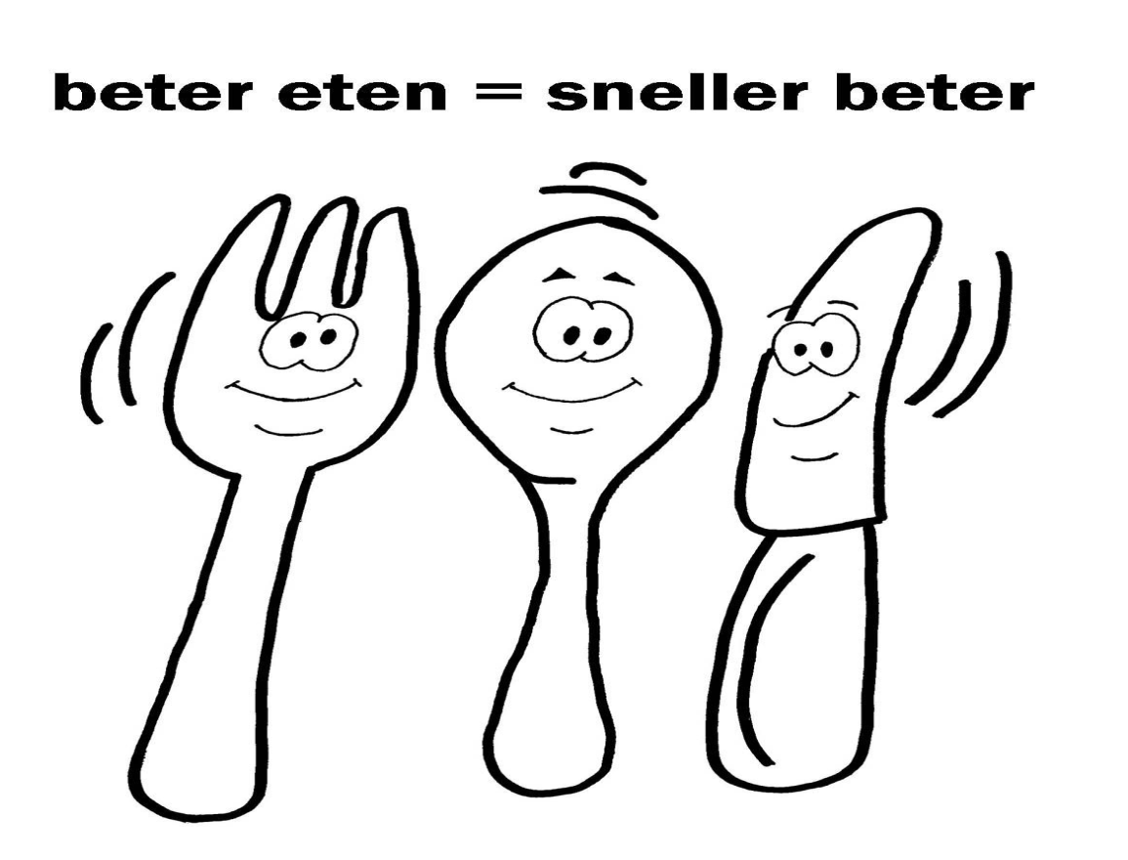
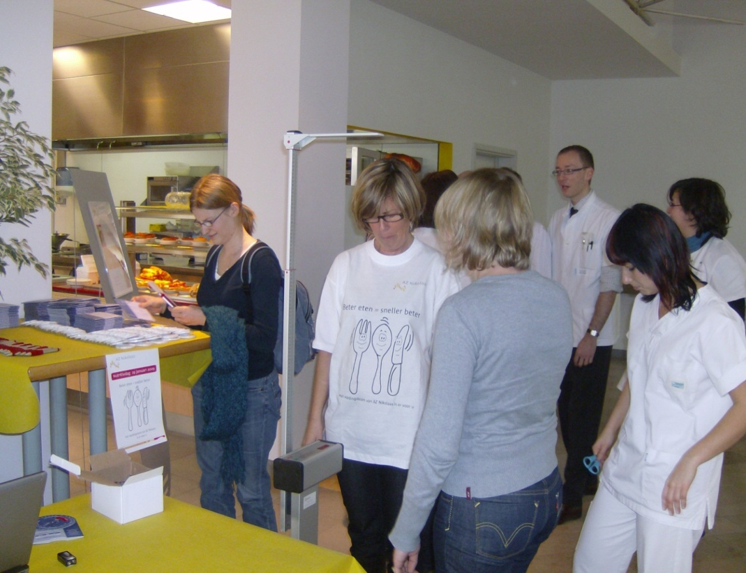
Nutrition Day in Europe: much more than just a cross-sectional audit
Kurt Boeykens, CNNS; Ivo Duysburgh, MD
¹Nutrition Support Team AZ Nikolaas, Sint-Niklaas (Belgium)
RATIONALE
IMPLEMENTATION
RESULTS
The Nutrition Day in Europe is a yearly well-known European cross-sectional audit to improve knowledge and enhance awareness about malnutrition in hospitals. That day re-quires a tremendous input on human resources because of the time-consuming data collection. This may be one of the reasons that in many hospitals only a few wards are able to participate. In 2009 the Nutrition Support Team (NST) of our hospital took the initiative to frame this action into a much broader perspective. The aim was to make the entire hospital and the media aware of the existence of malnutrition in hospitals. To achieve this goal numerous activi-ties were planned.
In the hospital restaurant special events were organized:
measurement of length and weight of hospital workers and visitors with calculation of the BMI. (Figure 3)
a quiz with simple questions on malnutrition.
fresh fruit juice, cake or donuts for hospital workers, patients and visitors.
Each patient got a special dessert at lunch together with a flyer offering some explanation on malnutrition (mainly the consequences) and the function of the NST.
Organization of a press conference and distribution of a press information file.
The launch of a poster campaign with the logo.
The NST coordinated all these activities thanks to a well-considered preparation and a perfect communication plan. Therefore, a special task force with staff members of several departments (catering, medical, nursing, dietetics, logistics) was formed. The activities were financially covered by the hospital and partly sponsored by some nutrition companies. On the Nutrition Day all members of the NST were present to supervise the activities.
In total 347 patients (68% of the occupied beds) were screened in one day. Forty-four per cent (n=153) was indicated as nutritionally at risk. Risk for undernourishment increased significant-ly with age (59,4 % ≥ 70). Unintentional weight loss of 10% was recorded in 16,8% of the patients and one in four patients had eaten less than 50% of the normal intake in the past week. A BMI of < 18,5 was present in 7,7% of patients. The risk for undernourishment was calculated separately for each ward. (Chart 1) High risk wards were oncology, pulmonary diseases, geriatrics and abdominal surgery. Some of these wards decided afterwards to continue with the screening process. The action was very much visible in the whole hospital. The press conference was a great success. Members of the NST gave interviews on two official radio stations and the initiative was a key item in the news on the public national television. (Figure 4)
ACTIVITIES
All hospital wards were asked to screen their patients with a screening instrument based on the NRS 2002 on a voluntary basis.
A special logo was created with the message : ‘Eating better = healing better’. (Figure 1)
T-shirts were printed with the logo in the front and ‘The Nutrition Support Team is there for you’ on the back.
The hospital management was involved in weighing and measuring patients. For this purpose they wore the T-shirts with the logo. (Figure 2)
We brought ambience during lunch in the geriatric wards by:
trying to get as many patients as possible to sit together in the dining room of the ward.
decorating the environment and the tables.
offering an aperitif before lunch.
Organization of a medical staff meeting on hospital malnutrition, closing up with a quiz.
CONCLUSIONS
The organization of additional activities during the Nutrition day gave it an extra local and regional dimension. All important ‘players’ linked up with nutrition policy - in and outside the hospital - were involved and awakened. The same procedure was repeated in 2010 with again reports on the Flemish commercial tele-vision and a local television station. The results were presented at a meeting of forty hospitals involved in the federal malnutrition pilot project. For 2011 we plan to invite all the local nursing homes to take part in this initiative too.
Figure 1. Logo of the Nutrition Day.
Figure 2. Hospital management weighing
and measuring patients
Figure 3. BMI measurements
in the hospital restaurant.
CONTACT
Kurt Boeykens
kurt.boeykens@aznikolaas.be
032 3 7602745
Figure 4. Key item in the news on the Flemish public television
Chart 1. Participating wards -the green bars indicating
risk for undernourishment.

